Slide 1


Robust Cardiac Feature Monitoring based on Millimeter-Wave Radar
$PhD Viva$ $∙$ Aug 2025
Yuanyuan Zhang
Electrical Eng. and Electronics, UoL & School of Advanced Technology, XJTLU
Principle Supervisor: | Dr. Rui Yang
Co-Supervisor: | Prof. Yi Huang
 | Prof. Steven Guan
 | Dr. Yutao Yue

Slide 2
Contents
Background and Challenges
Proposed Methods with Results
Study A: Efficient High-SNR Signal Acquisition
Study B: Robust Single-cycle ECG Generation
Study C: Robust Long-term ECG Generation
Study D: Alleviation of Data Scarcity
Conclusions and Future Work

Slide 3

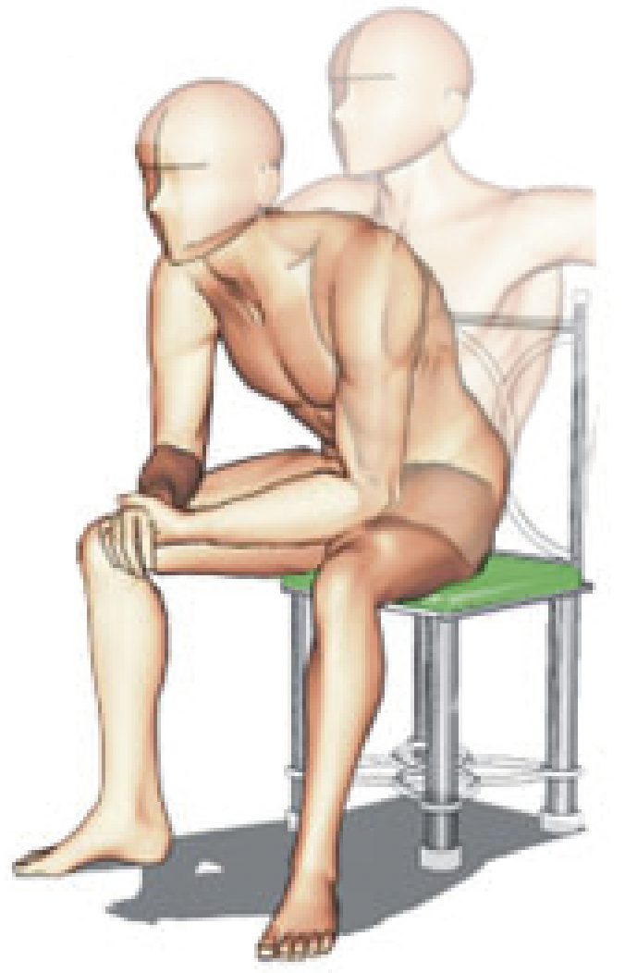
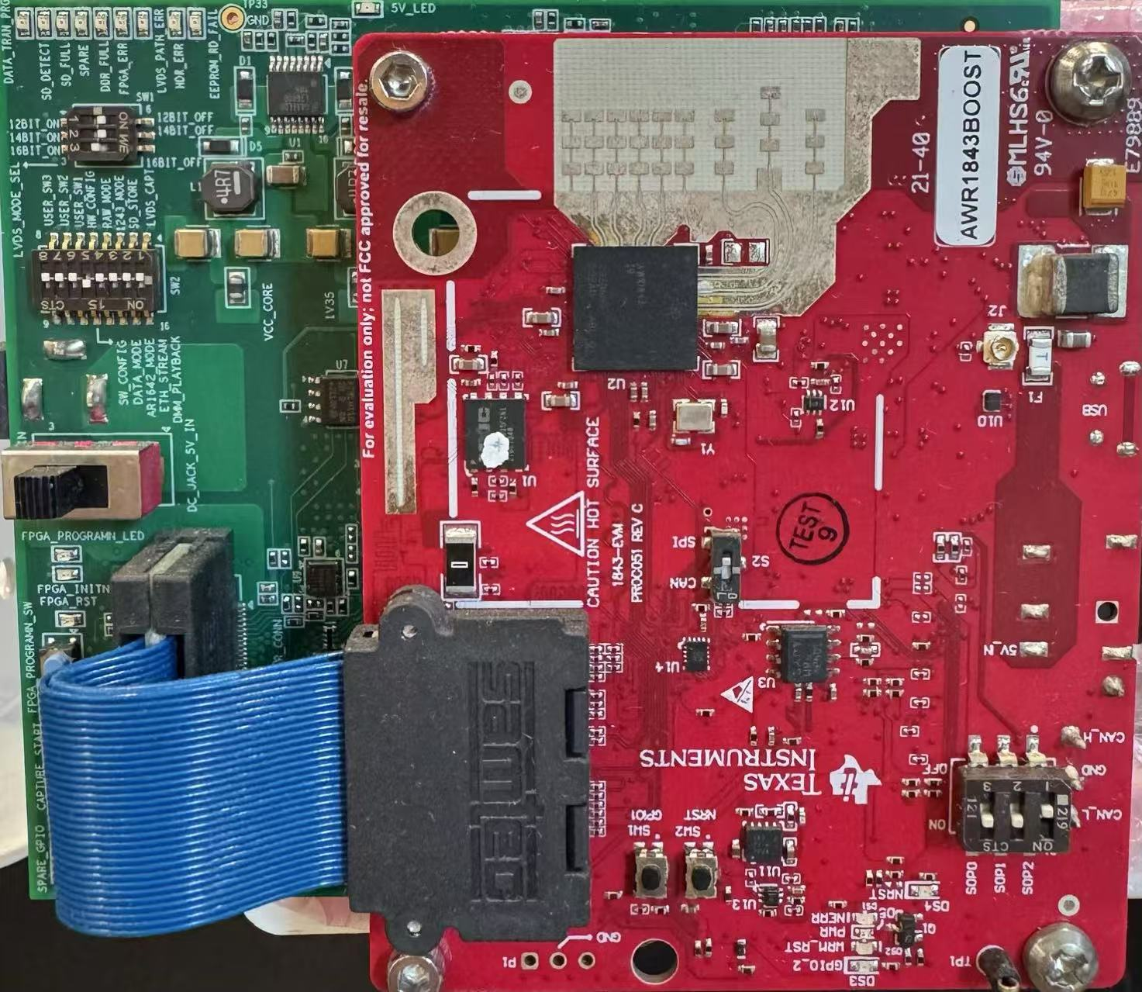
Background
Research Background – Radar-Based Sensing
Why we need contactless cardiac features monitoring?
Suitable for long-term monitoring or special patients (e.g., burn patients)
Suitable for in-cabin monitoring or smart home (e.g., healthcare scenarios)
ECG Monitor
Radar-based ECG Recovery
Why we use radar as the contactless sensor?
mmWave Radar
Sensors | Cameras | Acoustic Sensors | Wi-Fi Routers | Radars
Pros | SOTA. CV algorithms or DL frameworks | Directly monitor the heart sound | No need for extra devices Unobtrusive | Unobtrusive Contactless Robustness
Cons | Privacy issue Rely on high quality image. | Low accuracy Vulnerable to acoustic noise | Low accuracy Complex EM environment | Require special signal processing design Less investigated

Slide 4

Background
Research Background – General Pipeline

Slide 5
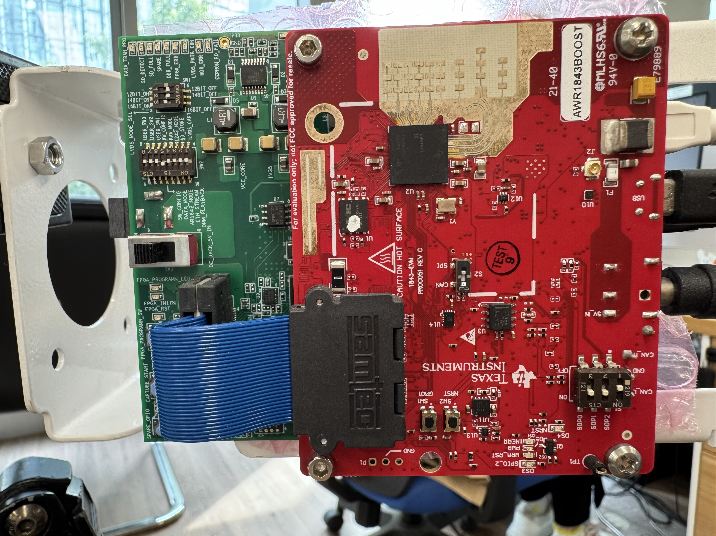
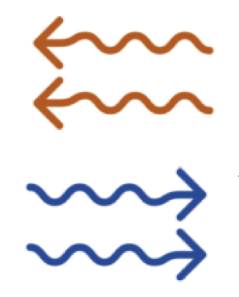
Background
Research Gaps and Contributions – Research Gaps
Illustration for radar-based ECG recovery :
Vital Sign
Radar
Signal Processing
ECG Recovery
Research gap in radar-based ECG recovery:
Design efficient algorithm for high-SNR signal collection.
Model and realize the domain transformation from radar to ECG for fine-grained cardiac features.
Realize long-term ECG recovery while mitigating the real-world noise (e.g., body movement, constant noise)
Alleviate data scarcity for the deployment in new scenarios with limited data.
Notes:
Already graduated and will get the degree in November

Slide 6
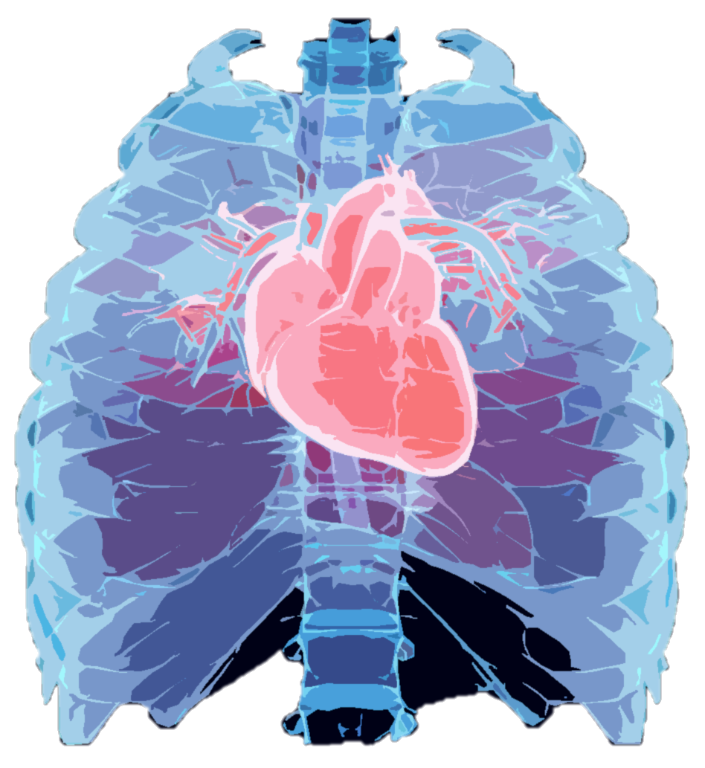
Background
Research Gaps and Contributions – Contributions
Contributions:
Thoroughly review the advanced methods for radar-based cardiac feature extraction (Chapter 2, published on TIM).
Propose a derivative-free optimization method to iteratively approach the point with ample cardiac features.
Design a signal model to describe the relationship between cardiac activities from different domains (radar to ECG).
Design the ODE decoder and multi-task learning framework to realize ECG recovery and resist constant/abrupt noises.
Propose an augmentation method and a transfer learning framework to alleviate data scarcity.
Pre-text Task Training
Backbone
Dec.
Low-SNR Signals
t
Sparse Signal Recovery
Knowledge
Transfer
0.4m
0.2m
Backbone
Dec.
0.4m
Search Space
High-SNR Signals
ECG Outputs
Fine-tuning
Chapter 3
Submitted to TMC
Chapter 4 and 5
Published in TMC and TIM
Chapter 6
Published in EMBC 2025

Slide 7
Background
Research Gaps and Contributions – Contributions
Contribution 1
Contribution 4
Contribution 2
Contribution 3

Slide 8
Part 2 – Proposed Methods
Study A

Slide 9
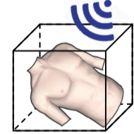
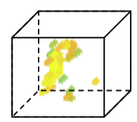
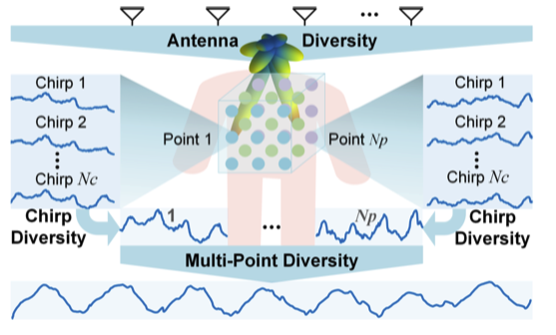
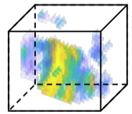
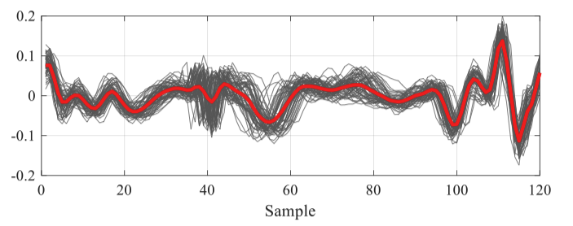
Study A
Efficient High-SNR Signal Acquisition - Problems
Clustering with exhaustive calculations [1]
Signal accumulation for noise suppression [2]
Limitations:
Time consuming
Rely on precise body localization
Not suitable for long distance
Limitations:
Rely on precise body localization
Could amplify non-gaussian noise
Only used for coarse vital sign, e.g., heartbeat monitoring
[1] J. Chen, D. Zhang, Z. Wu, F. Zhou, Q. Sun, and Y. Chen, “Contactless electrocardiogram monitoring with millimeter wave radar,” IEEE Transactions on Mobile Computing, Dec. 2022.
[2] J. Liu, J. Wang, Q. Gao, X. Li, M. Pan, and Y. Fang, “Diversity-enhanced robust device-free vital signs monitoring using mmWave signals,” IEEE Transactions on Mobile Computing, Jun. 2024.

Slide 10
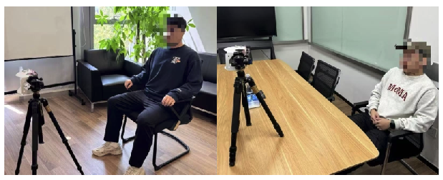
Study A
Efficient High-SNR Signal Acquisition - Contributions
Contributions:
Propose cardio-focusing and -tracking (CFT) algorithm to find cardio-focused (CF) points with clear cardiac features from a discontinuous objective space.
Provide a faithful approach to assessing SNR without knowing the ground truth, avoiding exhaustive calculations
The proposed CFT algorithm has been validated on sitting subjects in various scenarios and could provide radar measurements with better SNR compared with existing methods.
Data Collection scenarios
TI AWR-1843 @77GHz
with 3.8GHz bandwidth

Slide 11
Study A
Efficient High-SNR Signal Acquisition – Overview

Slide 12
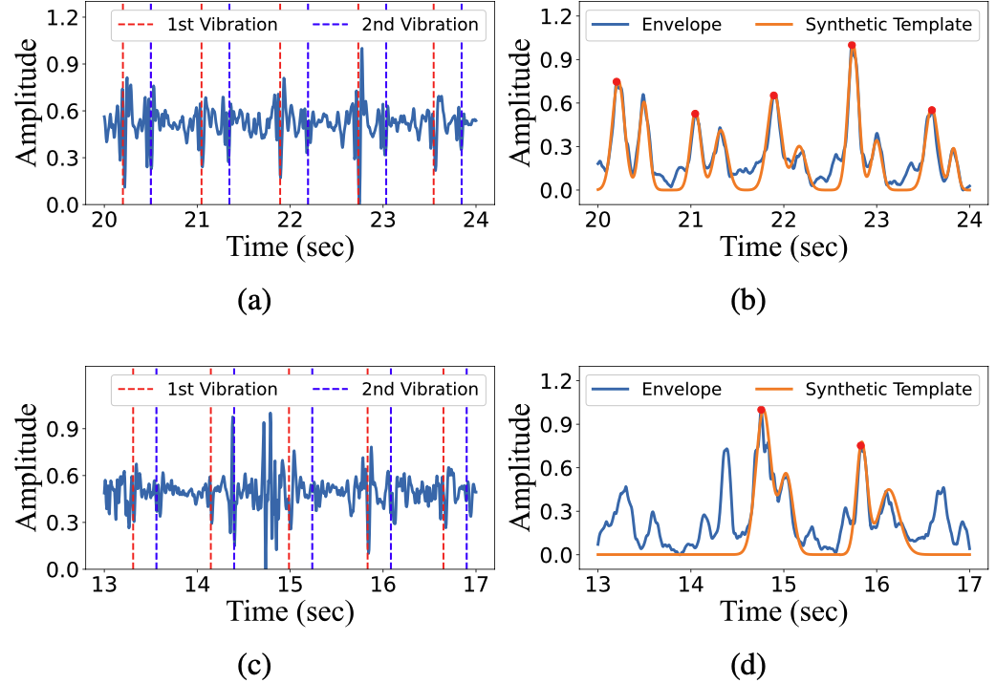
Study A
Efficient High-SNR Signal Acquisition – CFT
Advantages of CFT:
Provide a faithful approach to assessing SNR without knowing the ground truth, avoiding exhaustive calculations.
Suitable for the highly discontinuous objective space and could break local minima by restricting the search space.
High SNR
Low SNR
Assess signal SNR with universal template
Bold search region based on the spanning grids

Slide 13
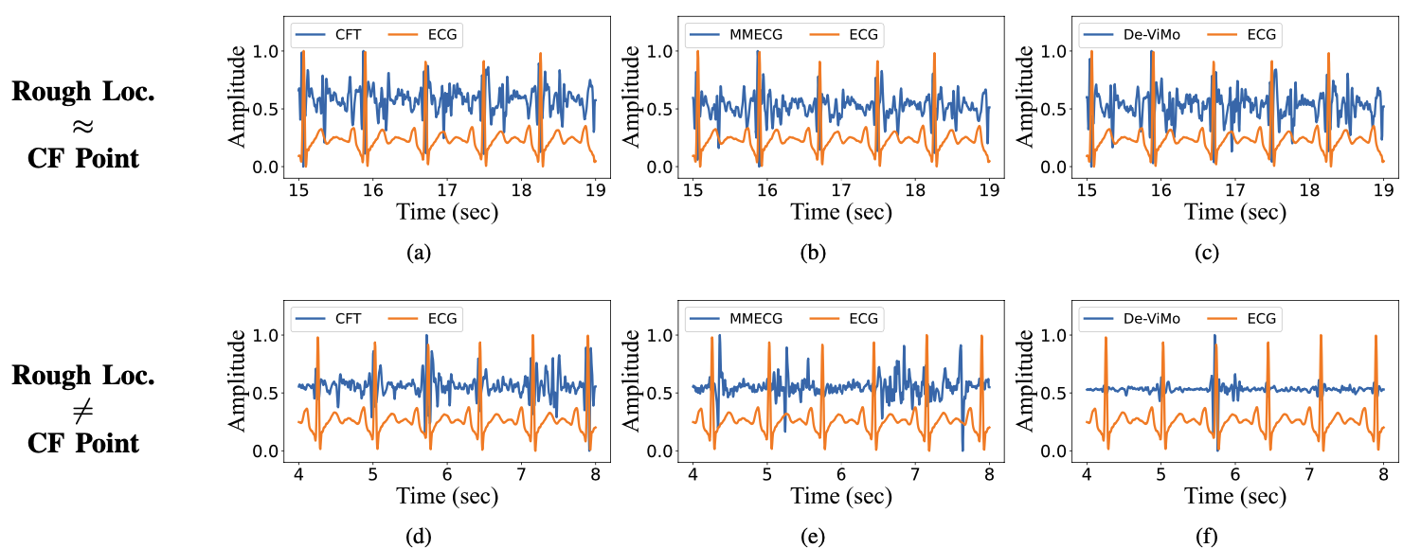
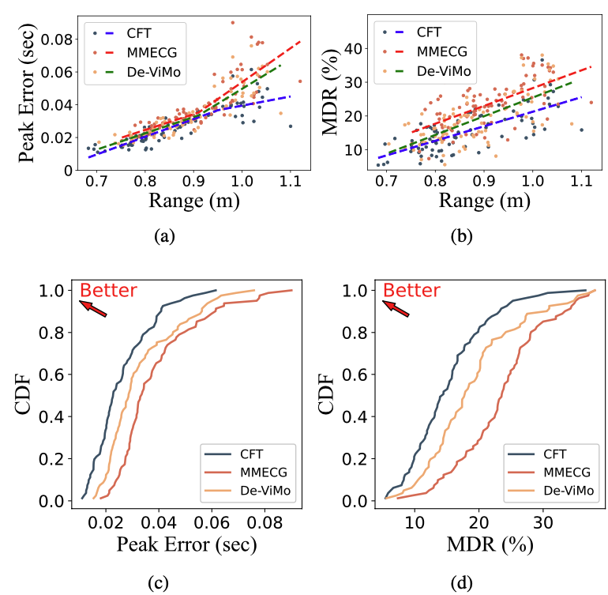
Study A
Efficient High-SNR Signal Acquisition – Results
Remarks:
Clustering- or accumulation-based method rely on a good initial estimation, but the FMCW signal processing could only provide rough body location.
The body posture is subject to change during data collection, causing a deviation of CF point by several decimeters. CFT could track the CF point by reactivating the optimization if SNR is low.

Slide 14
Part 2 – Proposed Methods
Study B

Slide 15
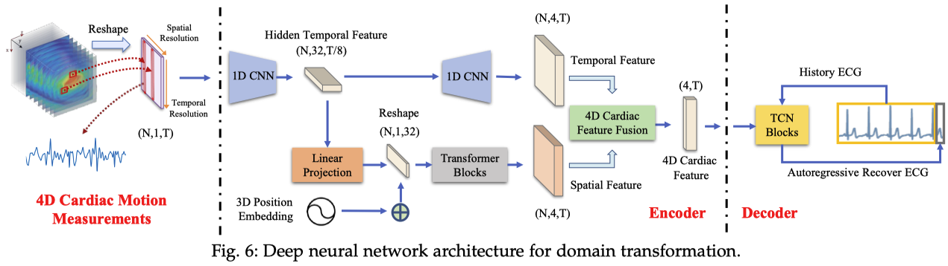
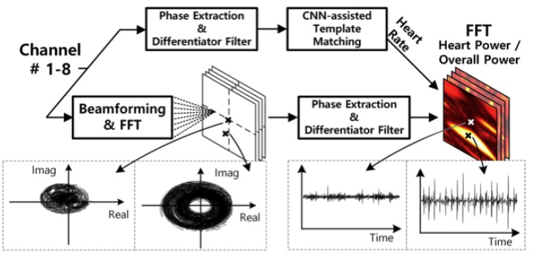
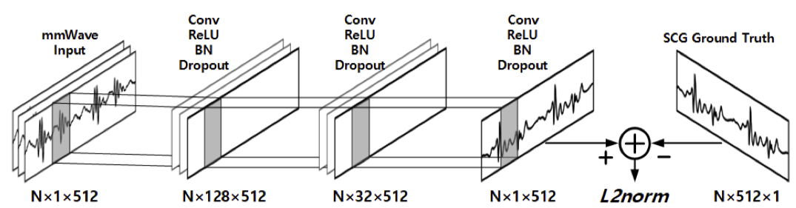
Study B
Robust Single-cycle ECG Generation – Existing Methods
[1]
[3]
[1] J. Chen, D. Zhang, Z. Wu, F. Zhou, Q. Sun, and Y. Chen, “Contactless electrocardiogram monitoring with millimeter wave radar,” IEEE Transactions on Mobile Computing, pp. 1–17, Oct. 2022.
[3] U. Ha, S. Assana, and F. Adib, “Contactless seismocardiography via deep learning radars,” in Proceedings of the 26th Annual International Conference on Mobile Computing and Networking (MobiCom), pp. 114, Apr. 2020.

Slide 16
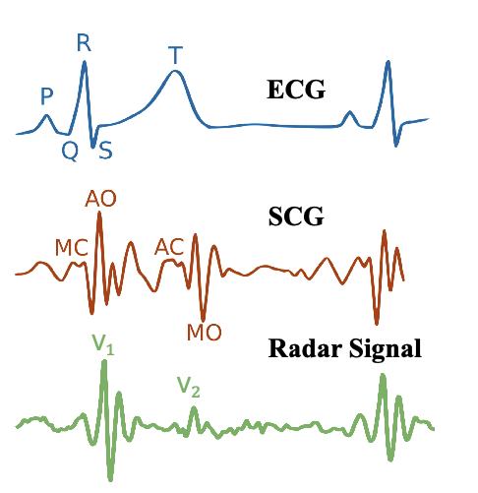
Study B
Robust Single-cycle ECG Generation – Preliminary
Domain transformation of cardiac features:
ECG Feature: P-wave, QRS-complex, T-wave for electrical activities of atrial/ ventricular depolarization/repolarization.
SCG Features: excitation–contraction coupling caused valve opening/closure (AO/AC) and mitral valve opening/closure (MO/MC)
Radar Feature: Similar with SCG but only with two prominent vibrations v1 and v2 induced by AO and AC.
Heart muscle contraction has a pulsatile nature, and the bones/tissues in chest area introduce the extra damping into the pulse [4], [5].
[4] M. Nosrati and N. Tavassolian, “High-accuracy heart rate variability monitoring using Doppler radar based on Gaussian pulse train modeling and FTPR algorithm,” IEEE Transactions on Microwave Theory and Techniques, vol. 66, no. 1, pp. 556–567, Jan. 2017.
[5] D. R. Morgan and M. G. Zierdt, “Novel signal processing techniques for doppler radar cardiopulmonary sensing,” Signal Processing, vol. 89, no. 1, pp. 45–66, Jan. 2009.

Slide 17
Study B
Robust Single-cycle ECG Generation – Contributions
Contributions:
Propose the signal model in terms of fine-grained cardiac features.
Design an ODE-embedded module called single-cycle ECG generator (SCEG) to parameterize the radar signal into sparse representations with morphological meanings.
By fusing the extracted morphological and temporal features, the proposed radarODE framework is proven to be robust in the presence of body movement noise and could realize accurate reconstruction of the ECG signal.
Distorted radar signal
Recovered ECG signal

Slide 18
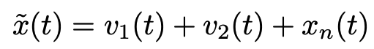
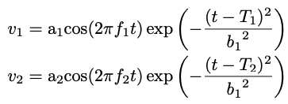
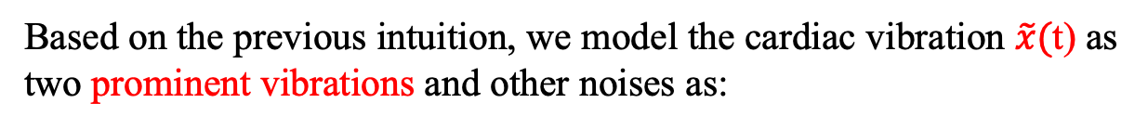
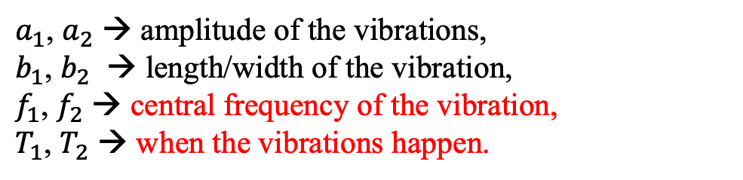
Study B
Robust Single-cycle ECG Generation – Signal Model
Proposed signal model:
Based on the previous intuition, we model the cardiac vibration $\tilde{x}(\text{t}\text{)}$ as two prominent vibrations and other noises as:
with
$a_{1}$, $a_{2}$ → amplitude of the vibrations,
$b_{1}$, $b_{2}$ → length/width of the vibration,
$f_{1}$, $f_{2}$ → central frequency of the vibration,
$T_{1}$, $T_{2}$ → when the vibrations happen.
Synthetic radar signal
Notes:
Already graduated and will get the degree in November

Slide 19
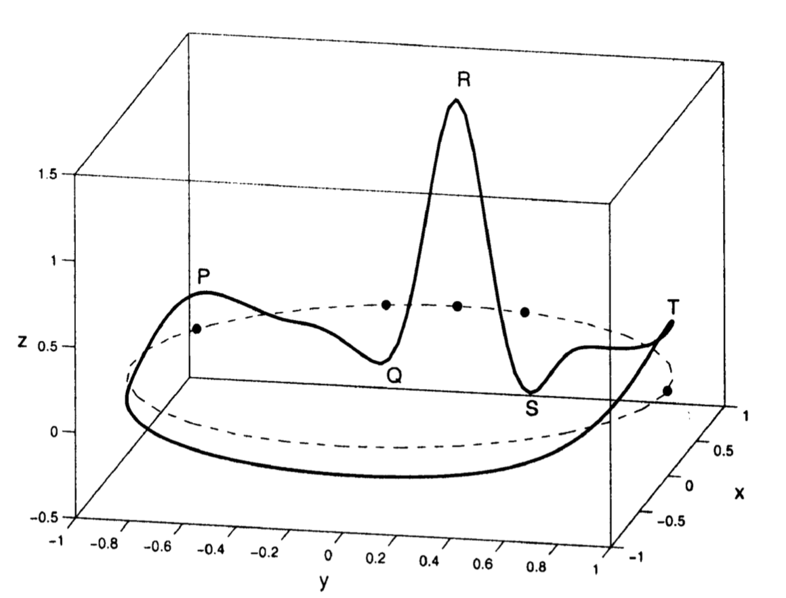
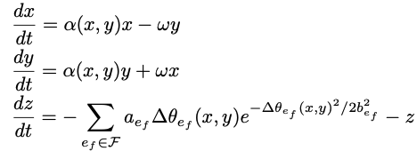
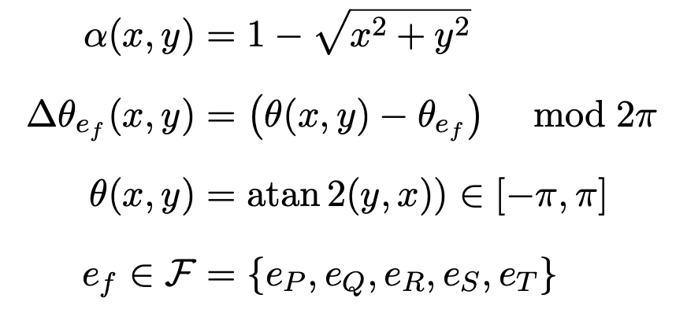
Study B
Robust Single-cycle ECG Generation – radarODE
Single Cycle ECG Generator (SCEG):
The ODE model describes a 3D trajectory denoted by $\text{(}x,y,z\text{)}$ [6]
[6] P. E. McSharry, G. D. Clifford, L. Tarassenko, and L. A. Smith, “A dynamical model for generating synthetic electrocardiogram signals,” IEEE transactions on biomedical engineering, vol. 50, no. 3, pp. 289–294, Mar. 2003.

Slide 20
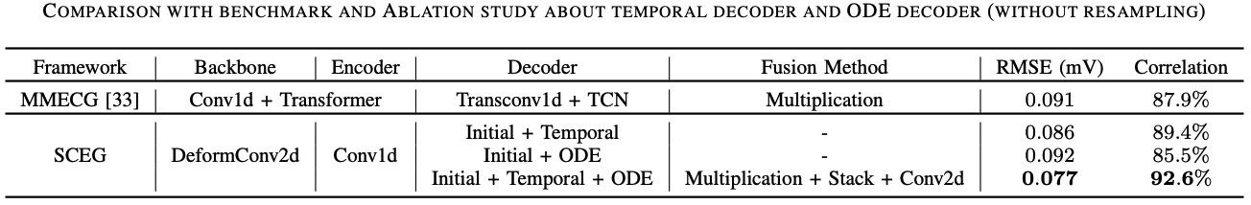
Study B
Robust Single-cycle ECG Generation – Results

Slide 21
Part 2 – Proposed Methods
Study C

Slide 22
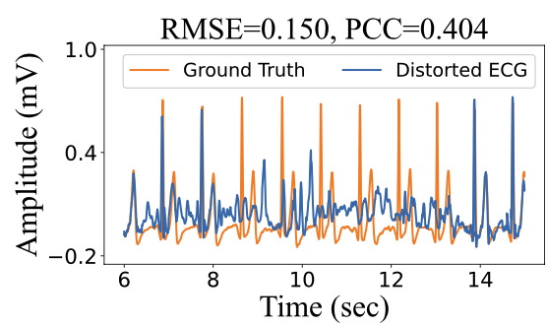
Study C
Robust Long-term ECG Generation – Research Gap
Research gap in radar-based ECG recovery:
The long-term domain transformation (radar to ECG) lacks theoretical explanation.
Noise robustness is never considered or validated in ECG recovery, especially for the DL model itself.
The misalignment issue in the method based on single cardiac cycle.
Distorted by noise
Well Aligned
Misaligned

Slide 23
Study C
Robust Long-term ECG Generation – Contributions
Contributions:
Model the radar-based ECG reconstruction into three tasks and design an MTL framework named radarODE-MTL to avoid the reintroduction of the time-domain noises and hence improve the noise robustness.
A novel optimization strategy eccentric gradient alignment (EGA) is proposed for MTL learning by eccentrically aligning the task gradients, aiming to adaptively alter the task priority to ensure efficient learning progress for the tasks with disparate complexity while preventing the negative transfer phenomenon at the same time.
Three Tasks:
…
Morphological Recovery
Cycle Length Estimation
ECG Anchor Estimation

Slide 24
Study C
Robust Long-term ECG Generation – radarODE-MTL
Framework Overview

Slide 25
Study C
Robust Long-term ECG Generation – EGA
(a) Original gradient space with gradient conflict and magnitude dominance
(b) The projection of the original gradient space into the orthogonal space with equal “learning rate”
(c) The implementation of eccentric gradient alignment to slant the joint gradient to the hard task by introducing the eccentric vector

Slide 26
Study C
Robust Long-term ECG Generation – Results

Slide 27
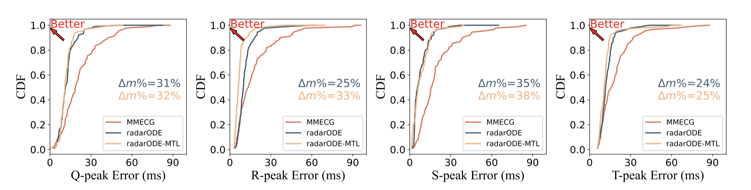
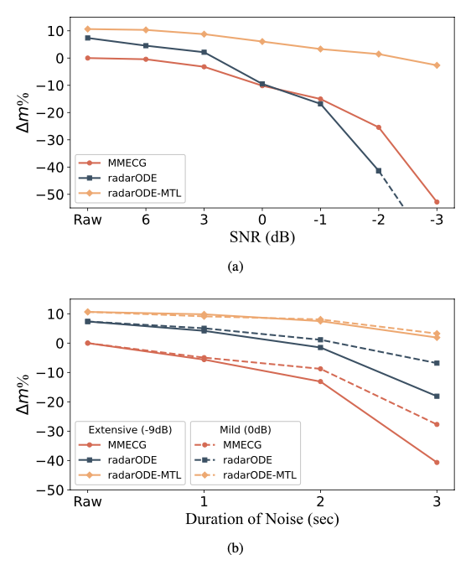
Study C
Robust Long-term ECG Generation – Results
Peak accuracy
Noise robustness test
Notes:
Already graduated and will get the degree in November

Slide 28
Part 2 – Proposed Methods
Study D

Slide 29
Study D
Alleviate Data Scarcity – Research Gap
Research gap in radar-based ECG recovery:
Limited data for deep learning model training, especially for new scenarios.
Unfaithful data augmentation for regression task. (e.g., mask, recombination, shift, flip, etc.)
Do not make full use of unlabeled radar signal for self-supervised learning (SSL).
Limited data may cause significant degradation
Traditional zero mask may cause missed detection

Slide 30
Study D
Alleviate Data Scarcity – Contributions
Contributions:
Propose Horcrux enhances the diversity of the limited dataset while preserving the intrinsic time consistency in the original signal and restricting the potential distribution shifts introduced into the augmented dataset.
Propose a transfer learning framework RFcardi following an SSL paradigm to eﬀectively learn the latent representations from radar signals by leveraging an appropriate pre-text task.
Time-domain consistency preserved using proposed Horcrux
ECG Recovery w/o or with pre-training

Slide 31
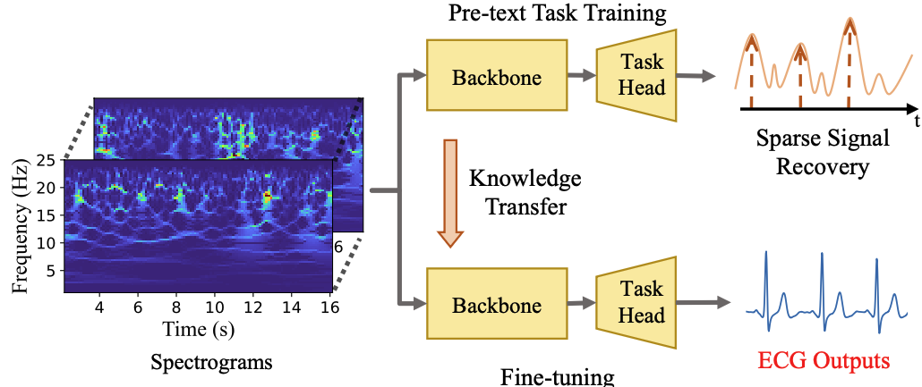
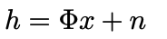
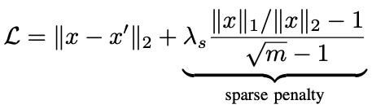
Study D
Alleviate Data Scarcity – Horcrux and RFcardi
Transfer learning framework (RFcardi)
SSL with pre-text Task
1. Sparse Signal Recovery
Data augmentation pipeline (Horcrux)
2. Loss function with sparse penalty from $[{0, λ}_{s})$

Slide 32
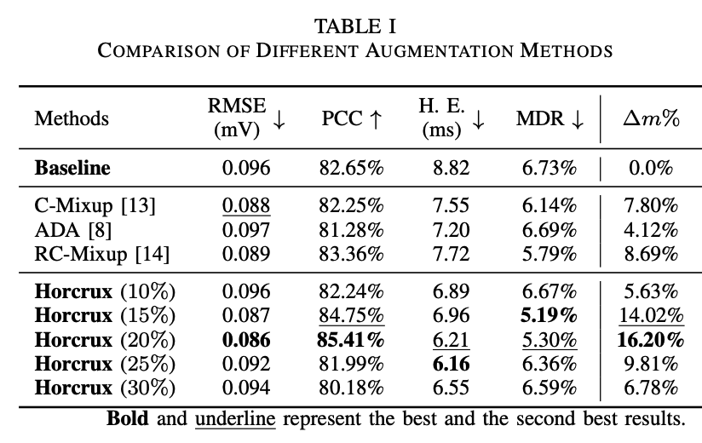
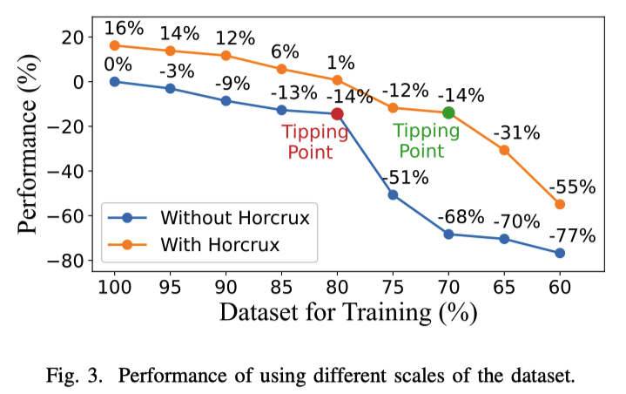
Study D
Alleviate Data Scarcity – Results of Horcrux

Slide 33
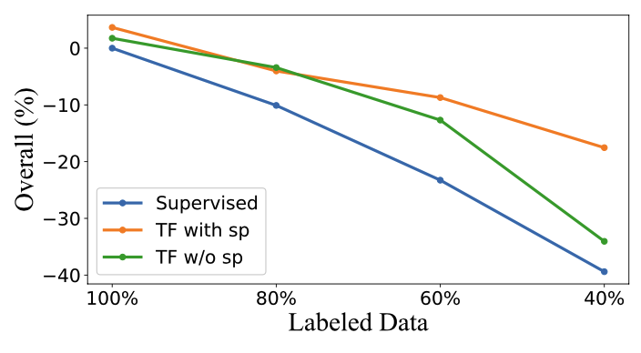
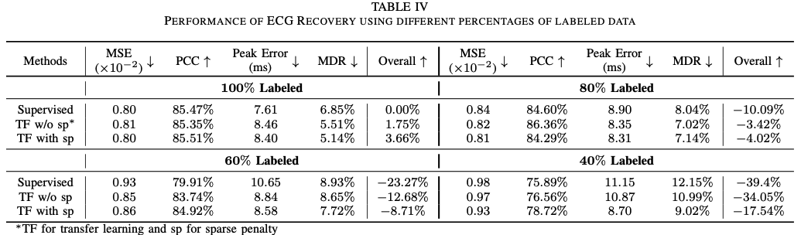
Study D
Alleviate Data Scarcity – Results of RFcardi

Slide 34
Part 3 – Conclusions and Future Work
Part 1 – Summary of contributions
Part 3 – Publications
Part 2 – Future work

Slide 35
Conclusions
Summary of contributions
Contributions:
Efficient data collection with ample cardiac features
Model the transformation between fine-grained cardiac features (mechanical domain to electrical domain).
Realize the long-term radar-based ECG recovery even under the impact of different noises.
Alleviate the data scarcity for the deployment in new scenarios with limited data.

Slide 36
Conclusions
Publications
Publications as first author:
Yuanyuan Zhang, Rui Yang, Yutao Yue, Eng Gee Lim, Zidong Wang, “An Overview of Algorithms for Contactless Cardiac Feature Extraction From Radar Signals: Advances and Challenges”, IEEE Transactions on Instrumentation and Measurement, Jul. 2023. (Chapter 2)
Yuanyuan Zhang, Haocheng Zhao, Sijie Xiong, Rui Yang, Eng Gee Lim, Yutao Yue, “From High-SNR Radar Signal to ECG: A Transfer Learning Model with Cardio-Focusing Algorithm for Scenarios with Limited Data”, IEEE Transactions on Mobile Computing. (Under Major Revision) (Chapter 3)
Yuanyuan Zhang, Runwei Guan, Lingxiao Li, Rui Yang, Yutao Yue, Eng Gee Lim, “radarODE: An ODE-Embedded Deep Learning Model for Contactless ECG Reconstruction from Millimeter-Wave Radar”, IEEE Transactions on Mobile Computing, Apr. 2025. (Chapter 4)
Yuanyuan Zhang, Rui Yang, Yutao Yue, Eng Gee Lim, “radarODE-MTL: A Multi-Task Learning Framework with Eccentric Gradient Alignment for Robust Radar-Based ECG Reconstruction”, IEEE Transactions on Instrumentation and Measurement, Apr. 2025. (Chapter 5)
Yuanyuan Zhang, Sijie Xiong, Rui Yang, Eng Gee Lim, Yutao Yue, “Recover from Horcrux: A Spectrogram Augmentation Method for Cardiac Feature Monitoring from Radar Signal Components”, in Proceedings of the 47th Annual International Conference of the IEEE Engineering in Medicine & Biology Society (EMBC2025), Jul. 2025. (Chapter 6)

Slide 37
Conclusions
Publications
Publications as co-author:
Sijie Xiong, Yuanyuan Zhang, Cheng Tang, Haoling Xiong, Yiding Li, Atsushi Shimada, “U-MA: A Unified Framework with Differential Mamba under Parallel U-Net Scheme for Time Series Forecasting”, Engineering Applications of Artificial Intelligence. (Under Review)
Sijie Xiong, Cheng Tang, Yuanyuan Zhang, Haoling Xiong, Youhao Xu, Atsushi Shimada, “CME-Mamba with Enhancing Nonlinear Dependencies for Time Series Forecasting”, Applied Soft Computing. (Under Review)
Sijie Xiong, Yuanyuan Zhang, Cheng Tang, Fumiya Okubo, Yinlong Hu, Atsushi Shimada, “PIDTracker: An Efficient 2D Controllable Holt-Winters Model for Glucose Monitoring”, in Proceedings of the AAAI Conference on Artificial Intelligence. (Under Review)
Sijie Xiong, Jianing Wang, Yuanyuan Zhang, Cheng Tang, Fumiya Okubo, Atsushi Shimada, “GlucoMixer: An Efficient Continuous Glucose Monitoring Model with Mixers”, in Proceedings of the AAAI Conference on Artificial Intelligence. (Under Review)

Slide 38
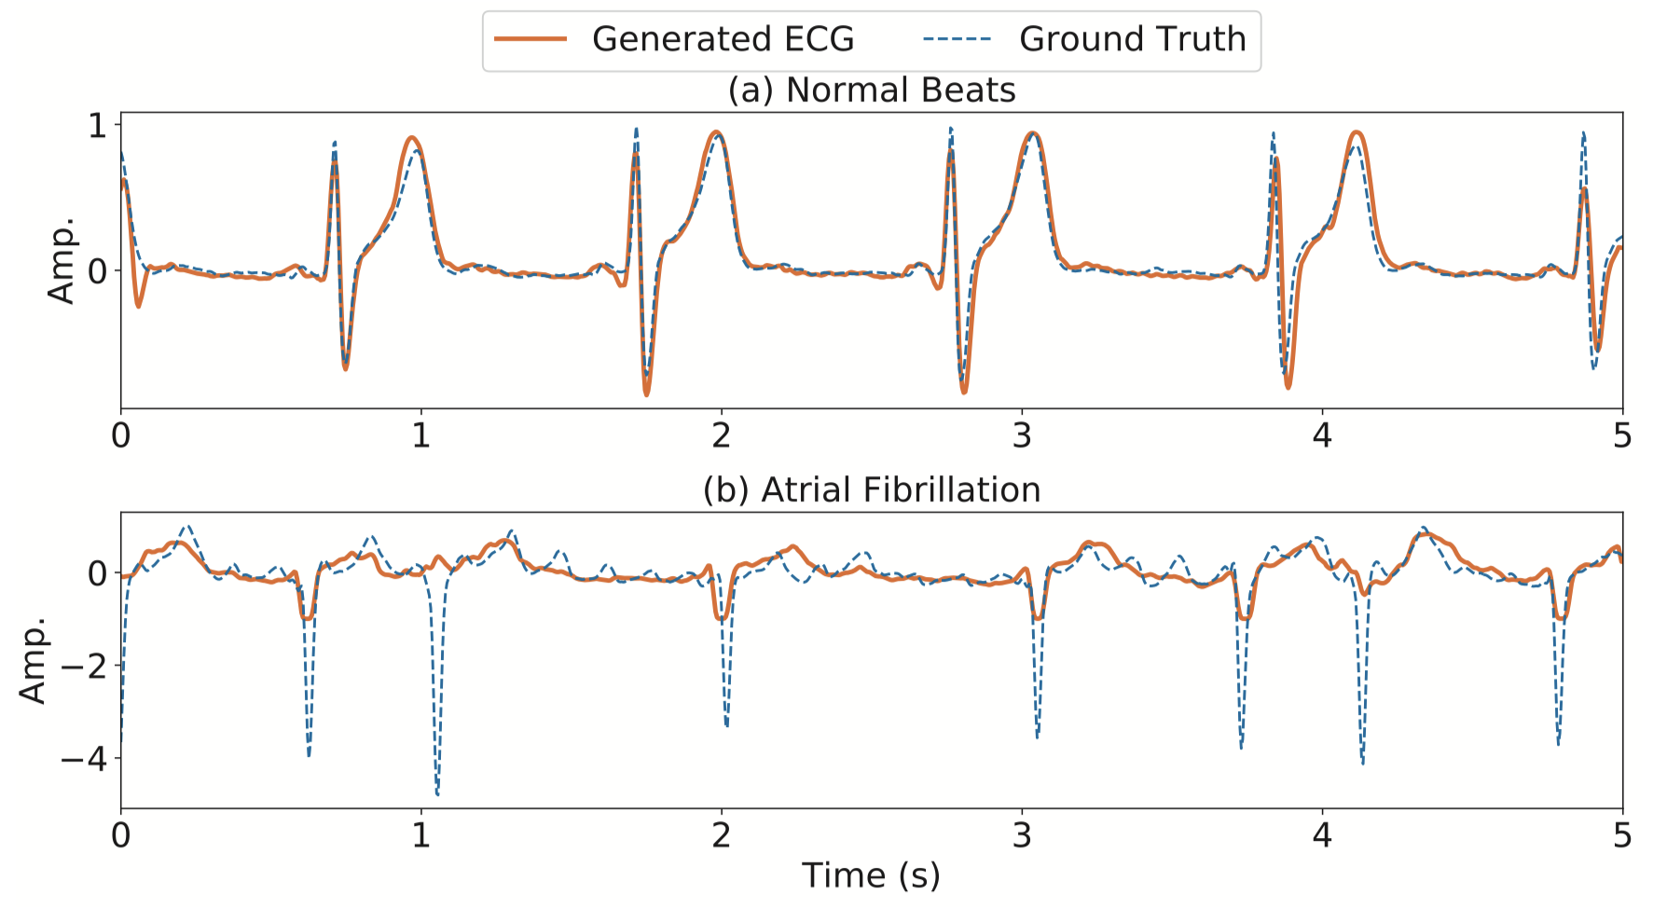
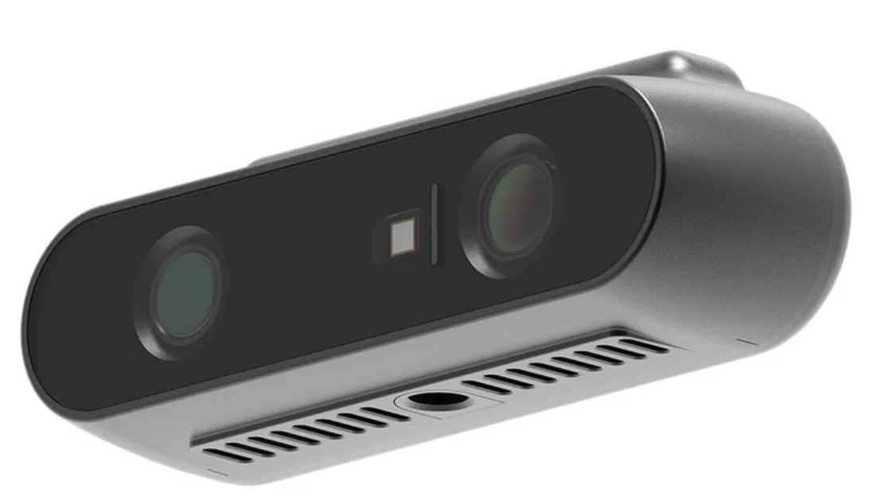
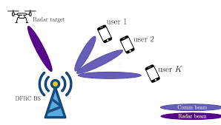

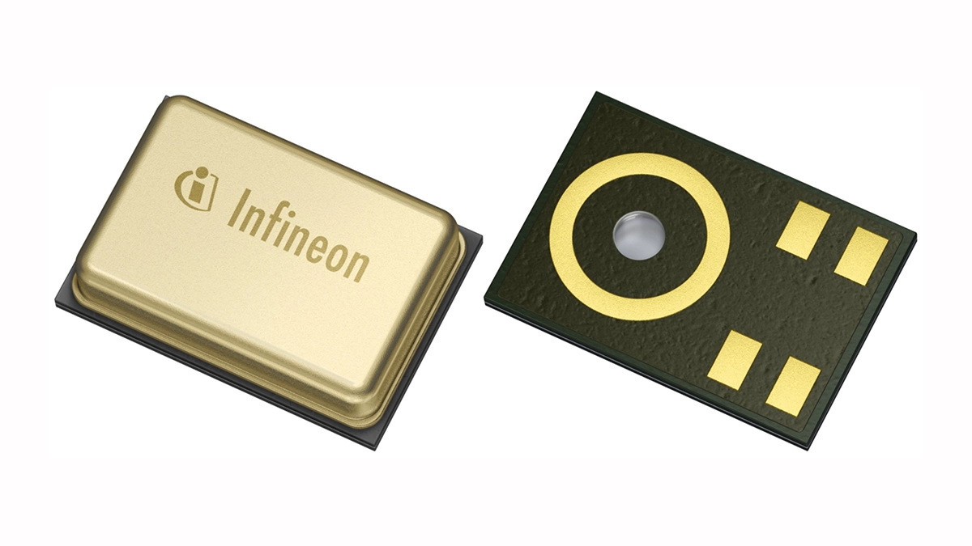
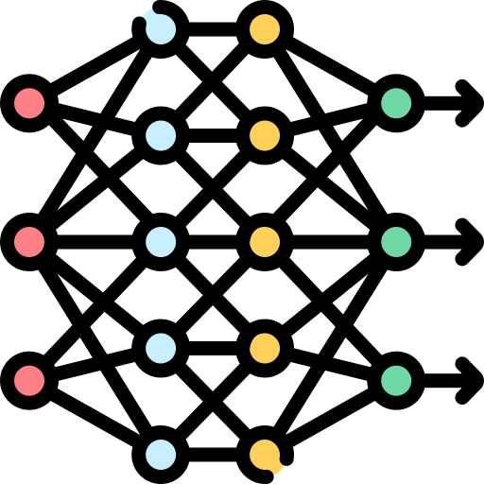

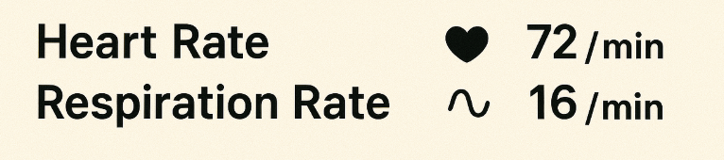
Conclusions
Conclusions – Future work
Future work:
Multi-sensor fusion for advanced healthcare monitoring.
Evaluation on the dataset for patients.
Integrated sensing and communication (for 6G).
ECG signal for patients
Camera
Audio
DL Info. Fusion
Health
Indicators
Radar
Multi-senor system for healthcare monitoring
ISCA

Slide 39
Q&A
Thanks for your time!

Slide 40
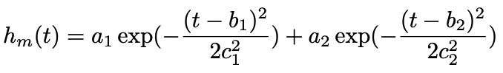
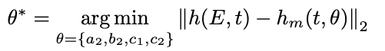
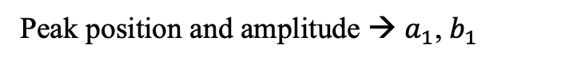
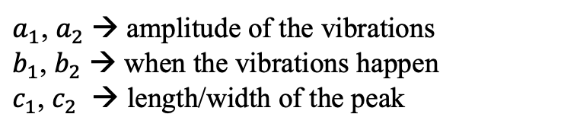
Supplementary Materials – Chapter 3
Assess signal SNR with universal template
1. Propose the dynamic template
$a_{1}$, $a_{2}$ → amplitude of the vibrations
$b_{1}$, $b_{2}$ → when the vibrations happen
$c_{1}$, $c_{2}$ → length/width of the peak
2. Identify incumbent peaks (red dots)
Peak position and amplitude → $a_{1}$, $b_{1}$
3. Run template matching
Notes:
Already graduated and will get the degree in November

Slide 41
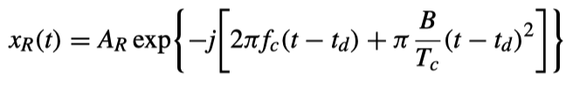
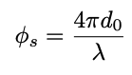
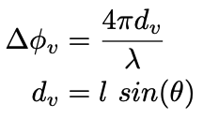
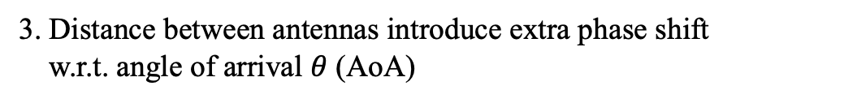
Supplementary Materials – Chapter 3
Range and Angle FFT
Phase
1. Received FMCW signal
2. Radar-human distance introduce phase shift
3. Distance between antennas introduce extra phase shift
w.r.t. angle of arrival $θ$ (AoA)

Slide 42






Supplementary Materials – Chapter 3
Objective
for each iteration $k$
Initialization
1. Initialization of grid $G_{k}$
Common coordinate search [3]
with grid size parameter $γ_{k}$ and search direction set $D$
2. Introduce search region $S_{k}$
with search size parameter $Γ_{k}$
Proposed CFT Algorithm
[3] J. Larson, M. Menickelly, and S. M. Wild, “Derivative-free optimization methods,” Acta Numerica, vol. 28, pp. 287–404, Jun. 2019.

Slide 43



Supplementary Materials – Chapter 3
Main Iteration
1. Initial Search Stage
Evaluate $ℱ(E)$ on a subset of grids $G_{k}$ based on any sampling algorithm (Latin hypercube sampling)
2. Resizing Stage
If success, move to new point and double $Γ_{k}$
If failed, run the same search inside search region $S_{k}$
If success, move to new point and double $Γ_{k}$
If failed, half $Γ_{k}$
Set

Slide 44











Supplementary Materials – Chapter 5
Define a MTL problem for n tasks:
for shared parameter space
The original task-specific gradient and the gradient matrix :
Project to orth. space
1. Formulate the projection problem:
with
Then we have:
2. The final projection problem:
Notes:
Already graduated and will get the degree in November

Slide 45








Supplementary Materials – Chapter 5
3. Find the solution for:
4. Borrow the solution of orthogonal Procrustes problem using SVD:
with solution
5. The new gradient matrix (using eigen decomposition) is:
with
6. The final solution is:
with unit singular values
The gradient conflict resolved □
Notes:
Already graduated and will get the degree in November

Slide 46



Supplementary Materials – Chapter 5
Gradient Normalization
1. The magnitude of each gradient $∝$ eigenvalues [4]
with
2. Get scaling factor for gradient normalization:
3. The new gradient matrix is:
The magnitude dominance resolved □
[4] D.Senushkin,N.Patakin,A.Kuznetsov,andA.Konushin,“Independent component alignment for multi-task learning,” in Proceedings of the IEEE/CVF Conference on Computer Vision and Pattern Recognition, Sep. 2023
Notes:
Already graduated and will get the degree in November

Slide 47








Supplementary Materials – Chapter 5
Introduce eccentric vector
1. Run several warmup epoch until the epoch
2. Record the loss values for all the tasks
3. Calculate learning rate:
(small lri for fast learning rate)
4. Calculate task difficulty weight and :
(small T enlarge discrepancy）
5. Get the final joint gradient:
The difficulty imbalance resolved □
Notes:
Already graduated and will get the degree in November

Slide 48
Supplementary Materials – Chapter 6
Challenges:
Efficiently extract high-SNR radar signals with ample cardiac features:
Assess signal SNR without ground truth.
Search for the high-SNR signal within a highly discontinuous space.
Learning common representations from unlabeled radar signals to assist supervised training with limited data.
Signal extracted form adjacent points (distance = 3cm)
Inference for the radar signal collected from new scenario

